Slide 1
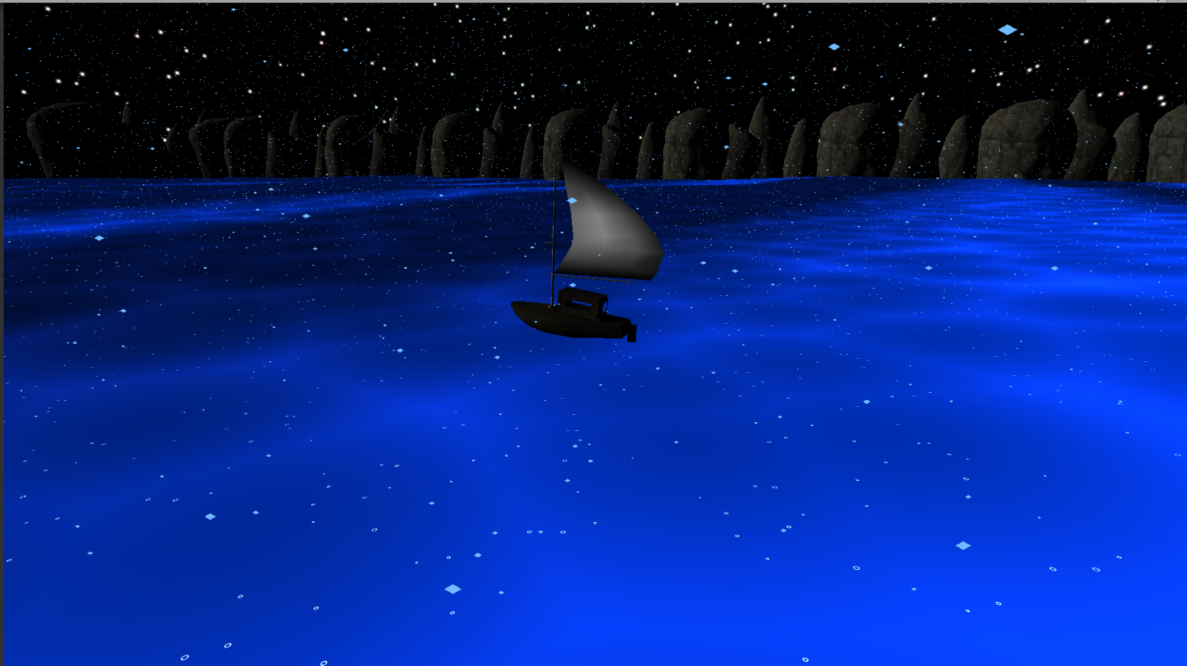
Shade of Water

Slide 2
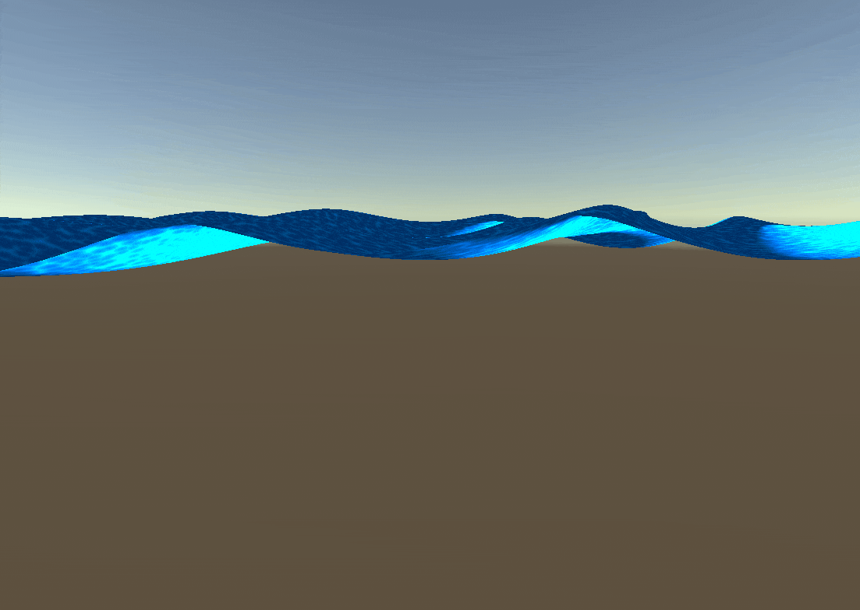
Water Shader
Gerstner Waves
An implemenation of waves using trochoidal waves
Instead of just changing y-coordinates, vertices get displaced in a circle
Foam highlight are made using Voronoi noise

Slide 3
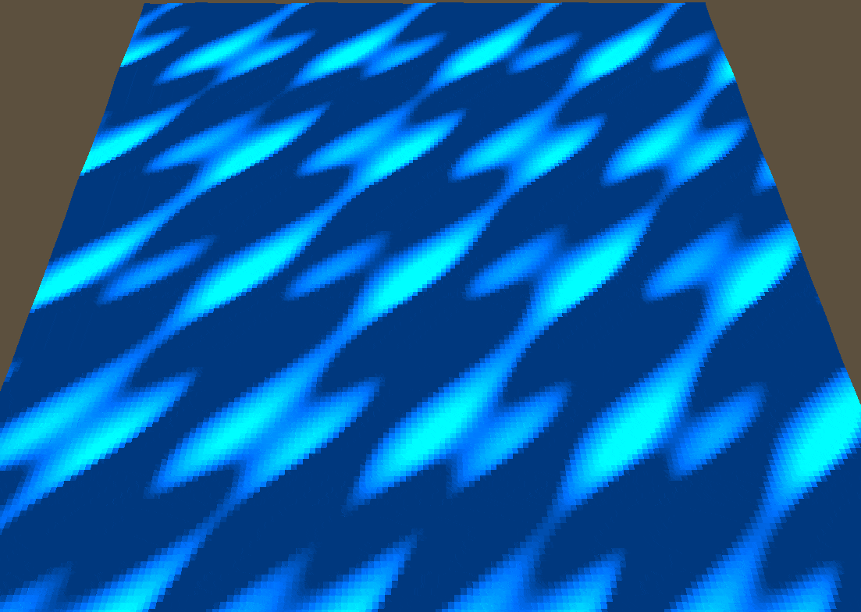
Low Poly Waves
An conversion of the former shader
Creates hard lines for a low poly look
Flat coloring on every triangle
Stronger highlights on waves
No Voronoi due to Flat Coloring

Slide 4
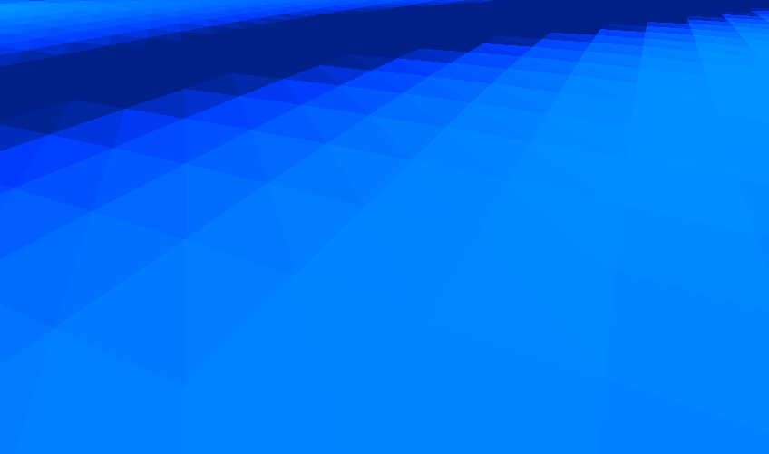
Low Poly Waves
An conversion of the former shader
Creates hard lines for a low poly look
Flat coloring on every triangle
Stronger highlights on waves
No Voronoi due to Flat Coloring

Slide 5
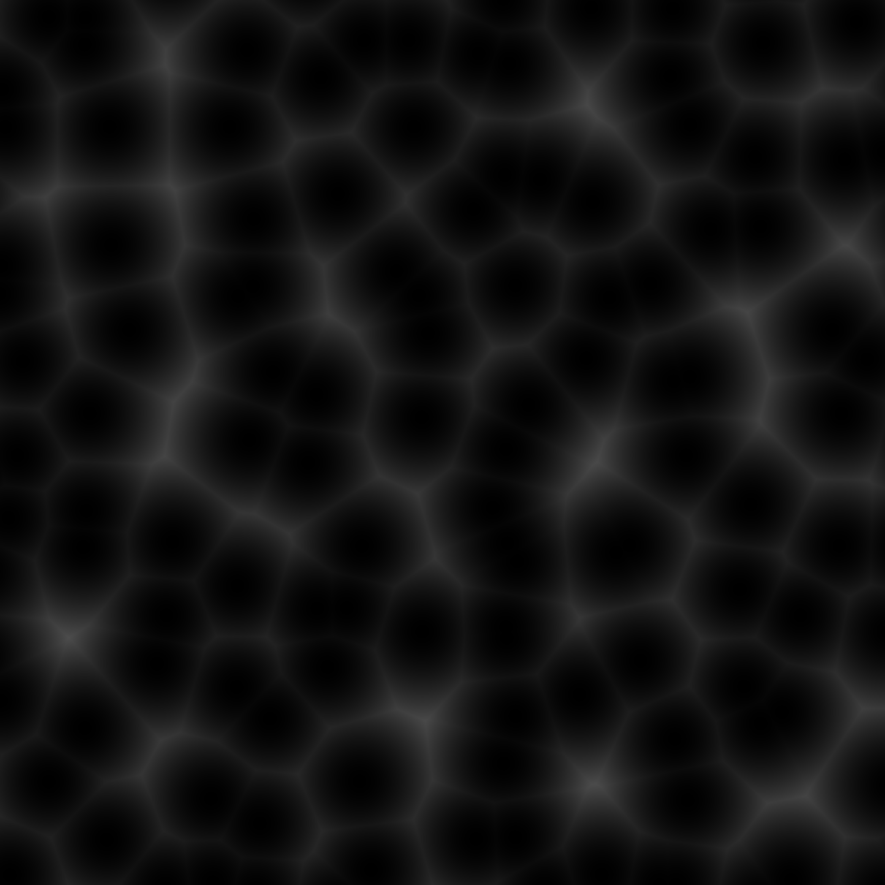
Voronoi Compute Shader
Voronoi/Worley/Cell Noise
Creates a noise image using Compute Shader
Simulates Cell structure
Used to make the water surface look more organic

Slide 6
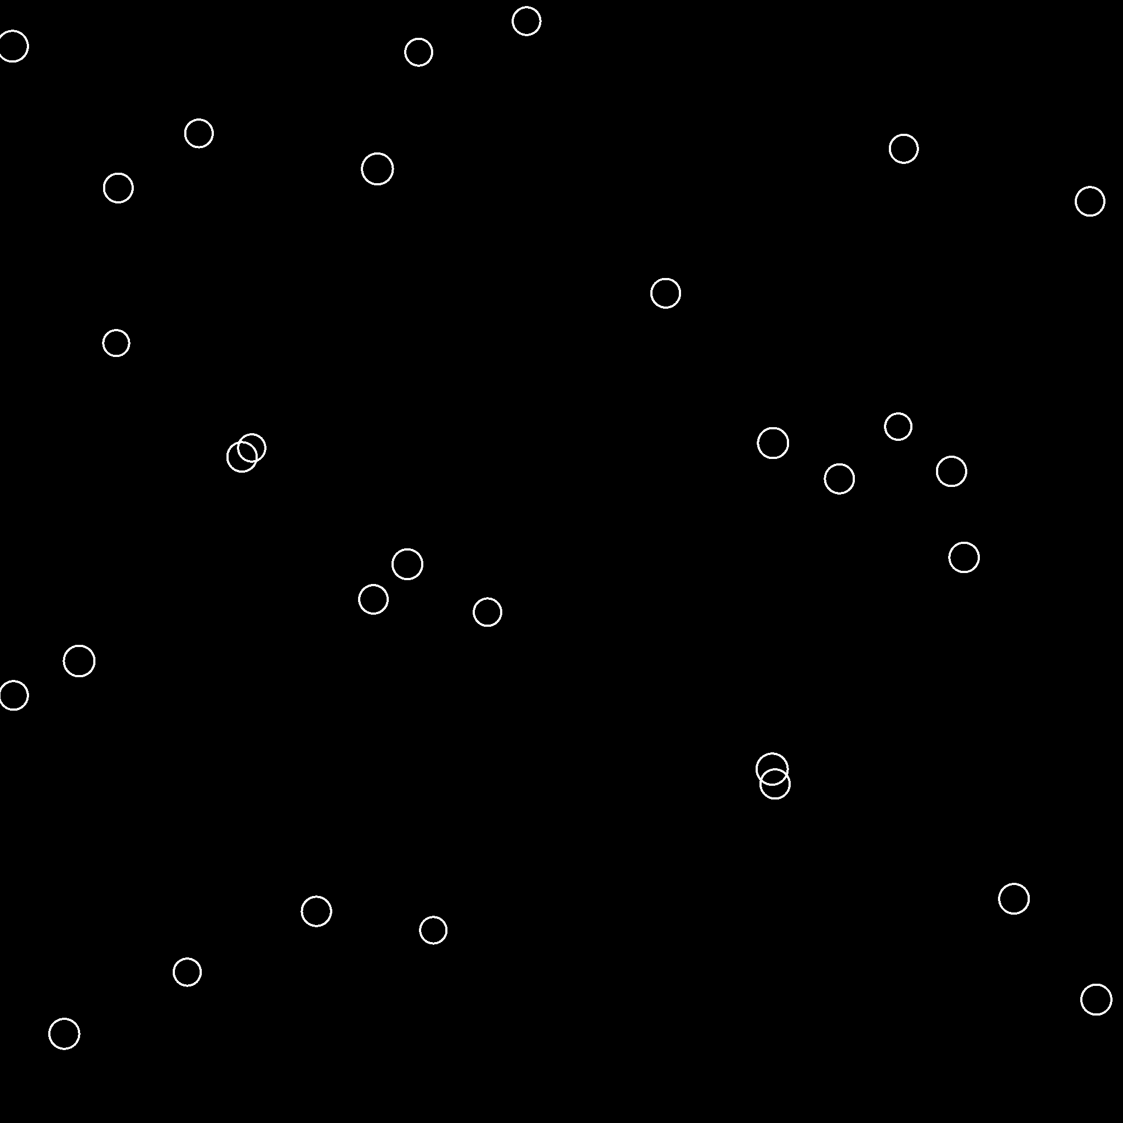
Raindrops
Forming Raindrops on the water using a Compute Shader
Forming little impact waves on the water surface
Calculated in Compute Shader
No Voronoi due to Flat coloring

Slide 7
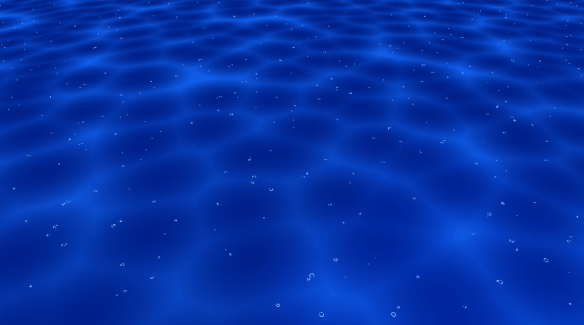

Slide 8
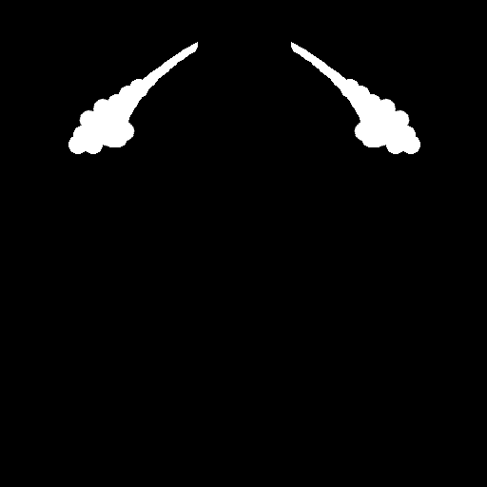
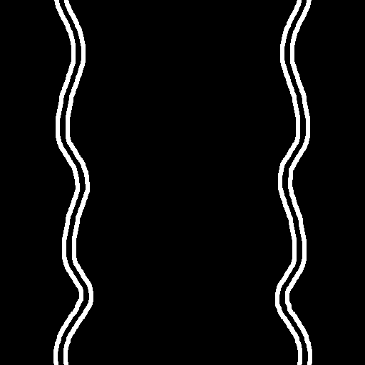
Boat Water Movement Shader
Emphasizes boat movement
Inserted into water shader as color term
Check if water fragment is inside rotatable square
Square at boat world coordinates
First texture top foam part
Second texture water movement scrolled

Slide 9
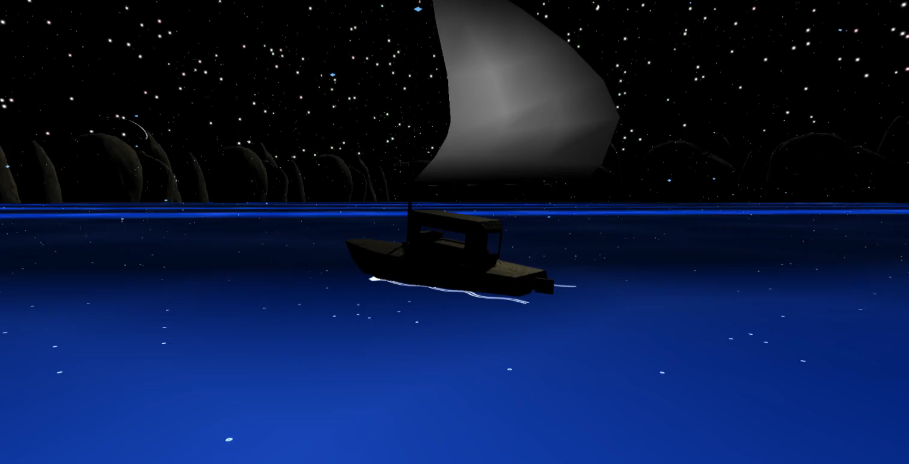

Slide 10
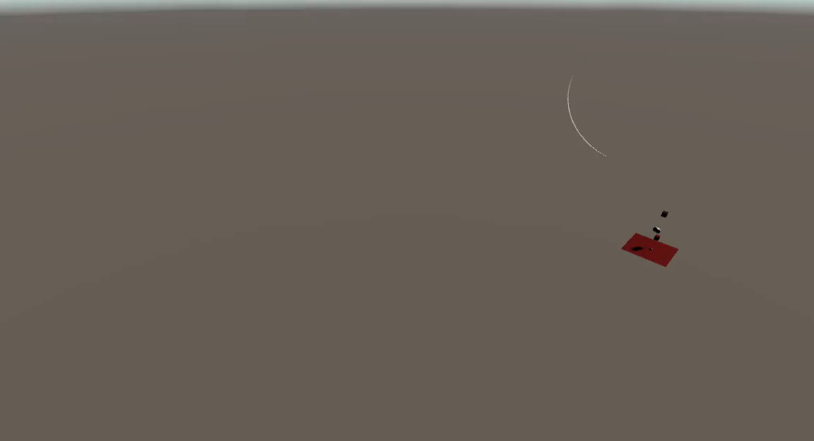
Wind Shader
Shows direction of in-game wind system
Row of quads mesh, configurable spiral form created in vertex shader
Visible wind band travels along mesh
Animated in fragment shader (max(sin(Term)))
Rotating mesh to mask mesh structure and increase variability

Slide 11
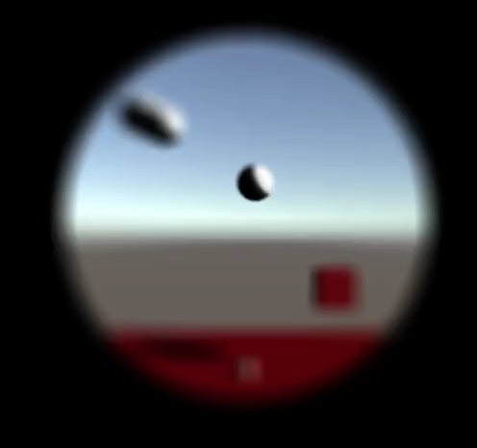
Telescope Shader
To search for lost cargo/treasure
Post processing
First pass circle
Second pass round gaussian blur
Blur strength depends on distance from middle
Pow factor to increase distortion on edge

Slide 12
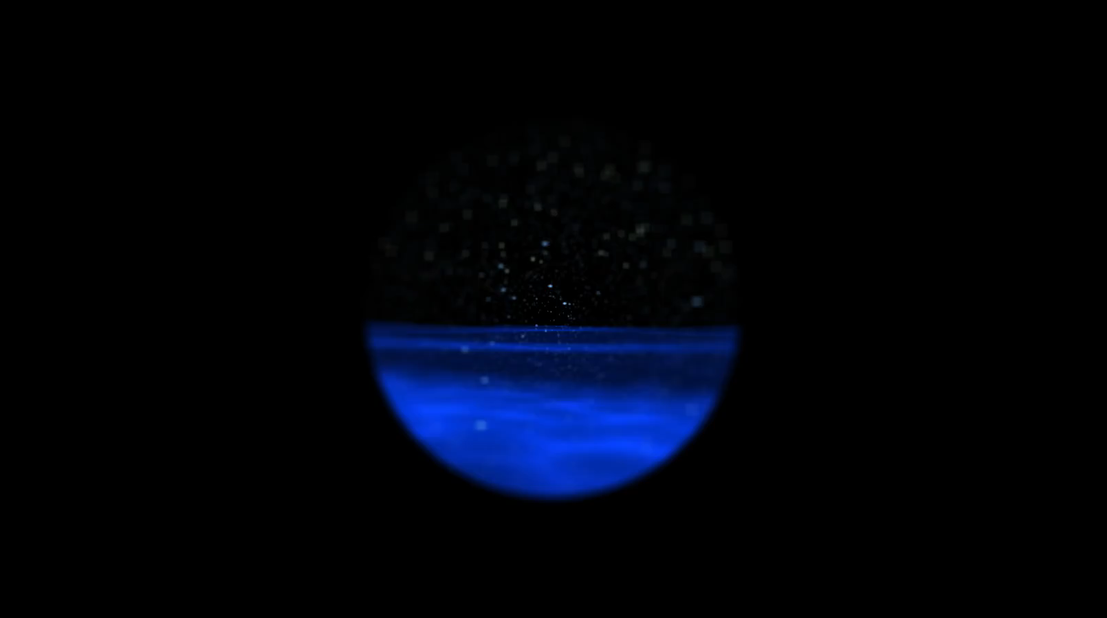

Slide 13
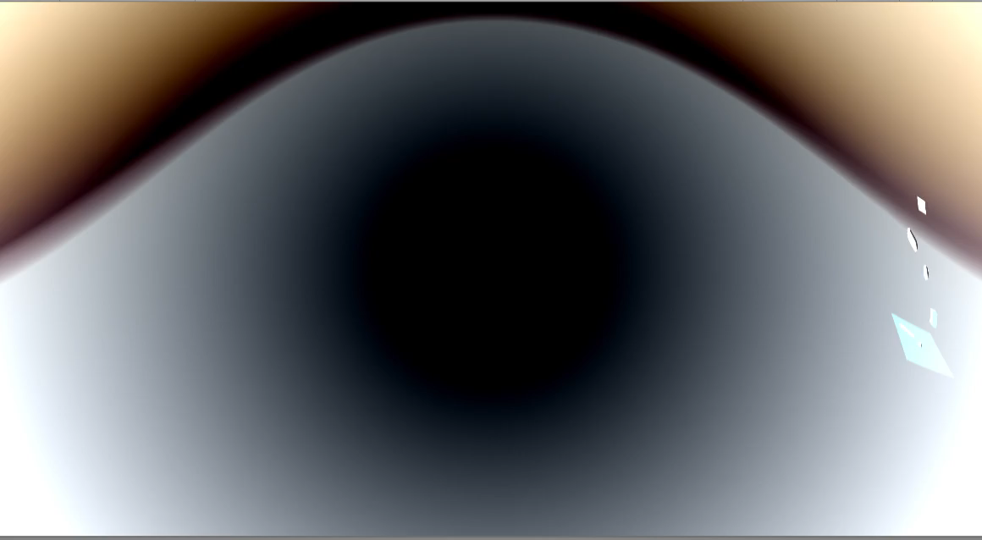
Event Horizon Shader
Game ender
Post processing
Distorts render texture
UV coordinates multiplied with mid distance
Inverted colors depending on mid distance

Slide 14
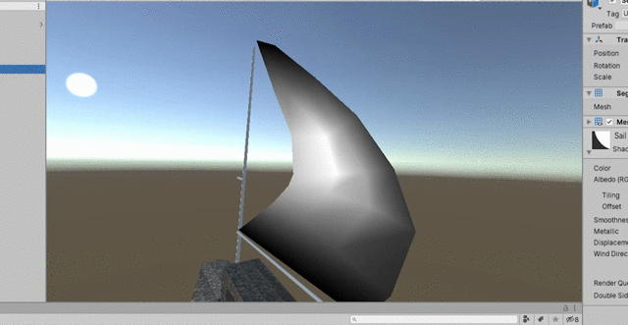
Sail Shader
Boat sail gets dynamically deformed
Wind Direction dictates scale of displacement
Sail vertices are color coded to emulate realistic deformation
White vertices: maximum displacment
Black vertices: no displacement
Dot product between wind direction and sail

Slide 15
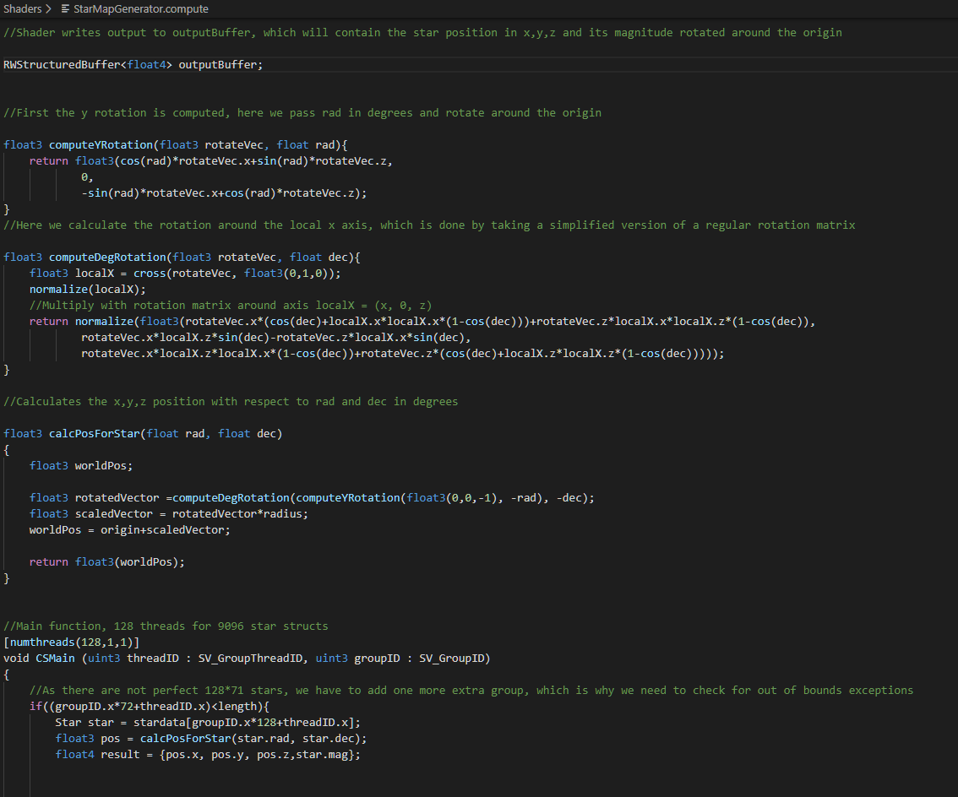
Star Compute Shader
Shader takes harvard database as input with each star having three properties
Right acension angle
Decension
Magnitude
Computes world Pos of each star
Passing each star into an output buffer
Runs on 128 threads with 71.x stars per thread = 9096 stars

Slide 16
Star Vertex Shader
Shader takes output buffer after compute shader calculations
Vertex shader just passes information and calculates one of three colors by star id
Geometry shader creates a quad for each vertex
Quads face camera at all times
Fragment shader maps star texture onto quad, multiplying it with one of three star colors

Slide 17
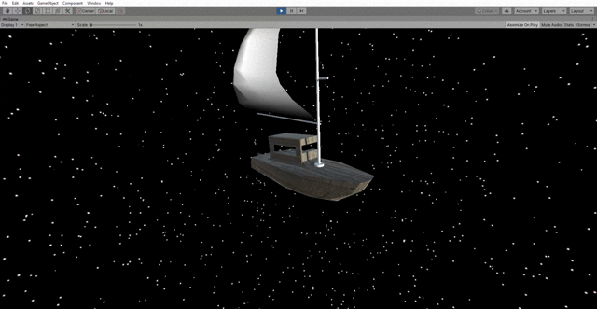

Slide 18
Vielen Dank für eure Aufmerksamkeit!

